Slide 1

WEB SCRAPING
USING PYTHON

Slide 2
Agenda
Introduction
About Project
Tools Required
Conclusion

Slide 3
Introduction
Web scraping is a powerful technique that allows us to extract valuable information from websites by programmatically navigating through their HTML structure. Using Python, a versatile and widely-used programming language, web scraping enables us to automate the process of gathering data, making it an essential tool for data scientists, researchers, and developers.

Slide 4
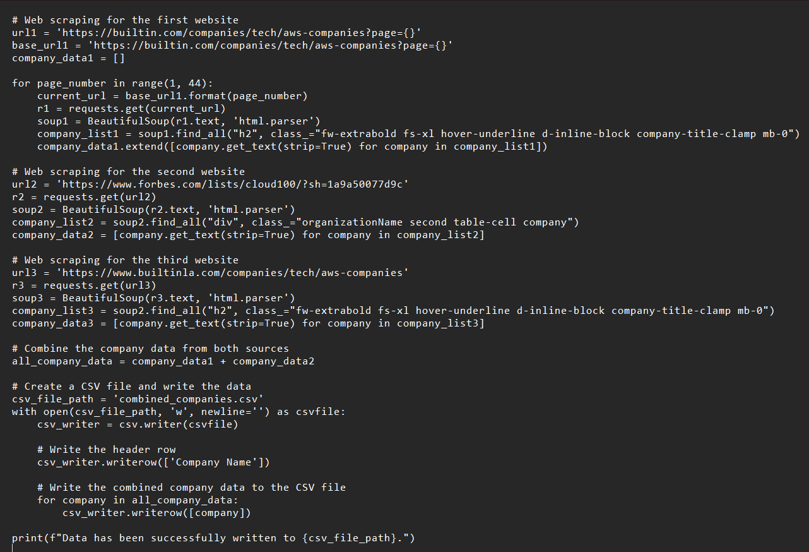
PROJECT CODE

Slide 5
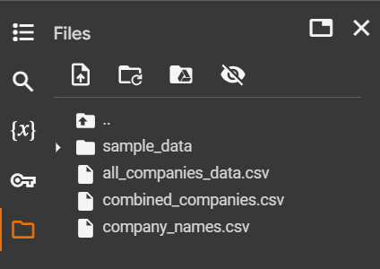
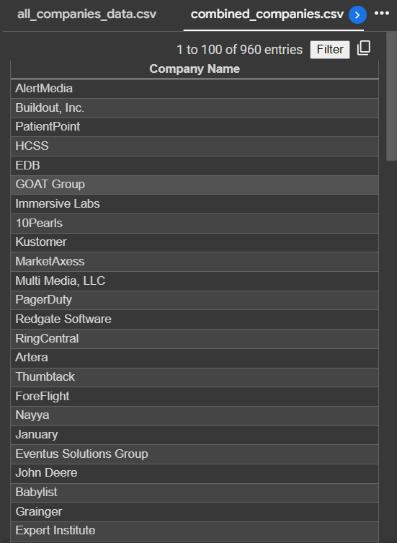
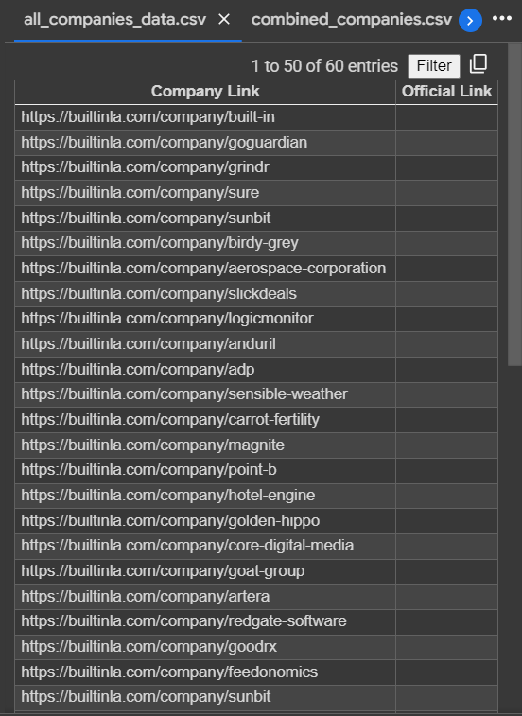
PROJECT OUTPUT

Slide 6
TOOLS :
Requests
BEAUTIFULSOUP
Scrapy
Selenium
LXML
Pandas
Regex (re)

Slide 7
Conclusion
In this web scraping project, we successfully gathered valuable information about companies listed on Built In LA. The project involved retrieving company names, links, and official links, showcasing the power of web scraping using Python

Slide 8
Thank you
SANTHAPRIYAN S
POOJA SHREE A E
SURYA K

